Slide 1
SONG RELEASE YEAR PREDICTION
CMPE 255 PROJECT PRESENTATION
Presented by:
Charanveer Singh
Hongjin Cheng
Moxank Prakashbhai Patel
Xinyu He
Group No: 10

Slide 2
Dataset Description
Name: Year Prediction Dataset (subset of MillionSongDataset)
Link: https://archive.ics.uci.edu/ml/datasets/YearPredictionMSD
Western and Commercial Tracks from 1922 to 2011
Attributes: 90
12 timbre average
78 timbre covariance
Instances: 515345

Slide 3
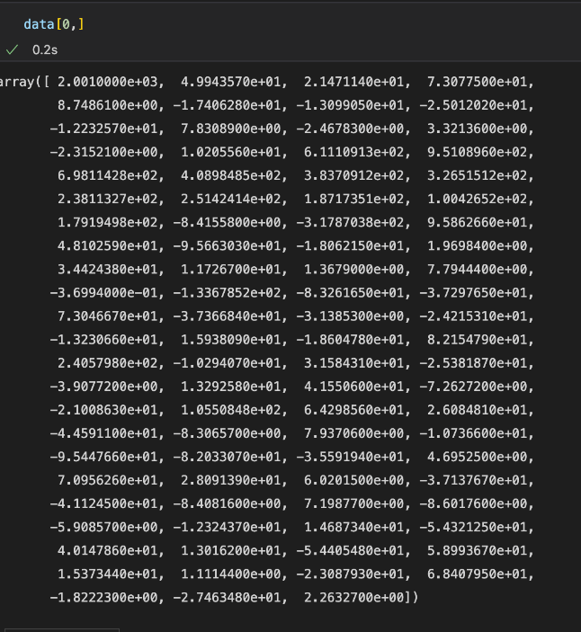
Dataset Description
Predictive Method
use some variable (timbre) to predict unknown variable (song year)
The first column is the label of the record. The next 12 are the timbre average and remaining are timbre covariance.
Figure 1: Dataset Sample

Slide 4
Part One:Data Pre-Processing
1.1 Feature Extraction
1.2 Feature Selection
1.3 Data Visualization
1.4 PCA (Dimensionality Reduction)
1.5 Splitting data into training and testing
1.6 Balancing the imbalanced dataset

Slide 5
1.1 Data Cleaning
Data Preparation is the process of transforming raw data into an understandable format
NULL/Missing values
Drop Duplicate Values
Detecting Outliers
Data Organization for easy analysis

Slide 6
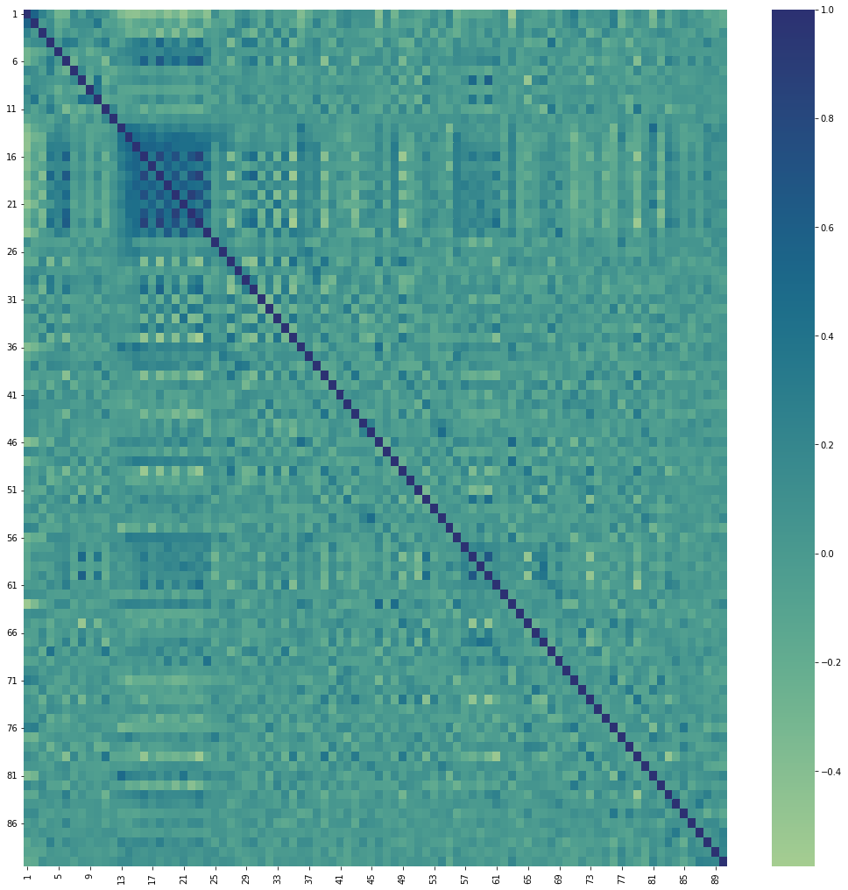
1.2 Feature Subset Selection
When creating a predictive model. Feature selection is the process of minimizing the number of input variables. It is preferable to limit the number of input variables in order to reduce modeling computational cost and , in some cases, increase the model performance.
Figure 2: Correlation Heatmap

Slide 7
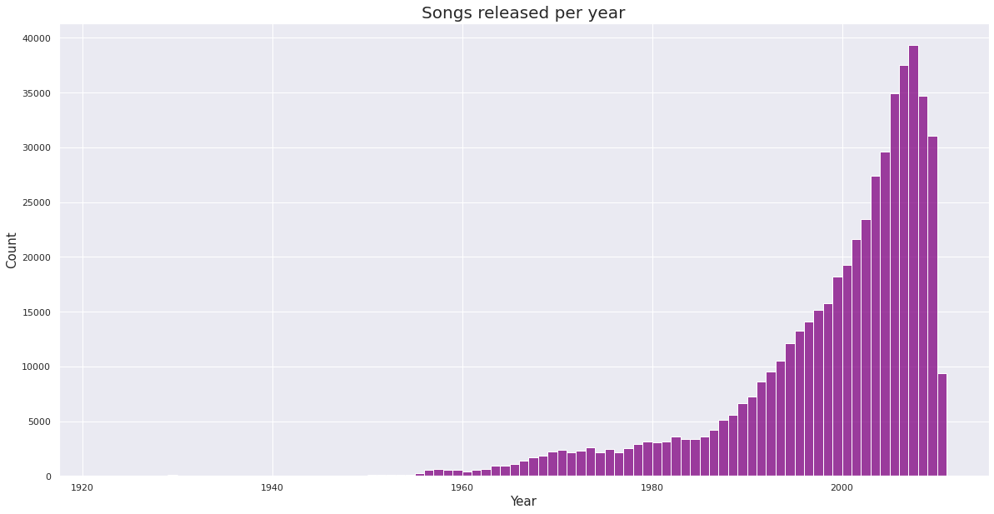
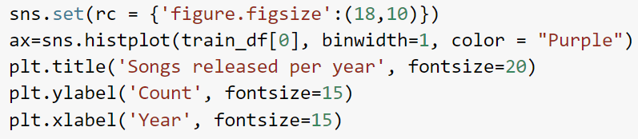
1.3 Data Visualization
graphical representation of information and data to understand trends, outliers, and patterns in dataset better.
Figure 3: Dataset Visualization

Slide 8
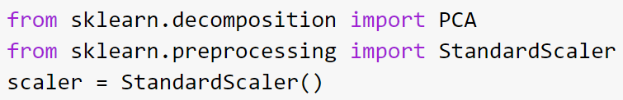
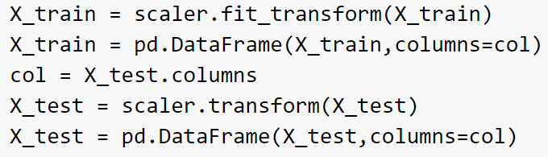
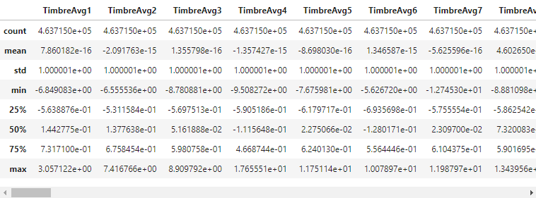
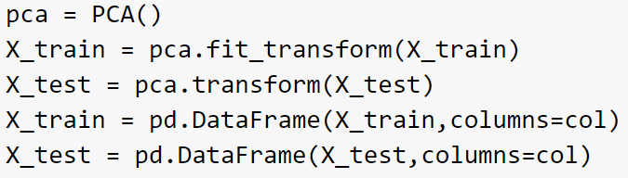
1.4 PCA (Dimensionality Reduction)
interested in the components that maximize the variance
From https://github.com/raghav1810/Music-analysis-and-Year-prediction/blob/master/release-year-prediction-on-msd.ipynb
Figure 4: PCA

Slide 9
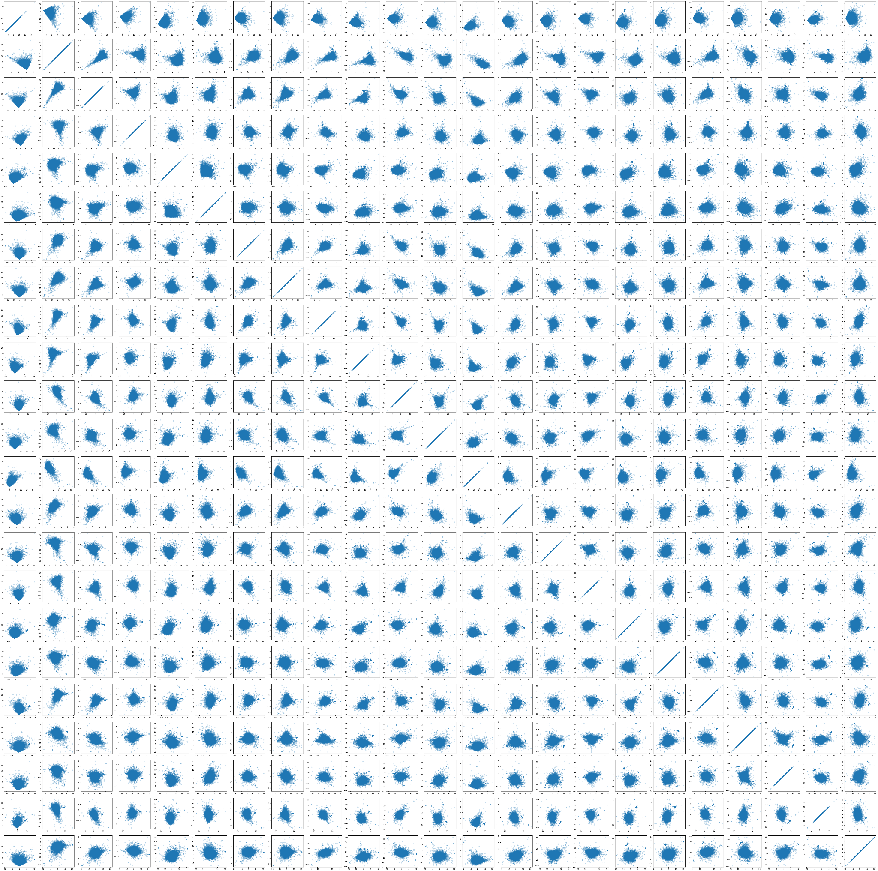
1.4 PCA (Dimensionality Reduction)
We only kept transformed features that accounted for 95% of the variance
Those were first 17 features
Figure 5: Scatter plot of transformed data

Slide 10
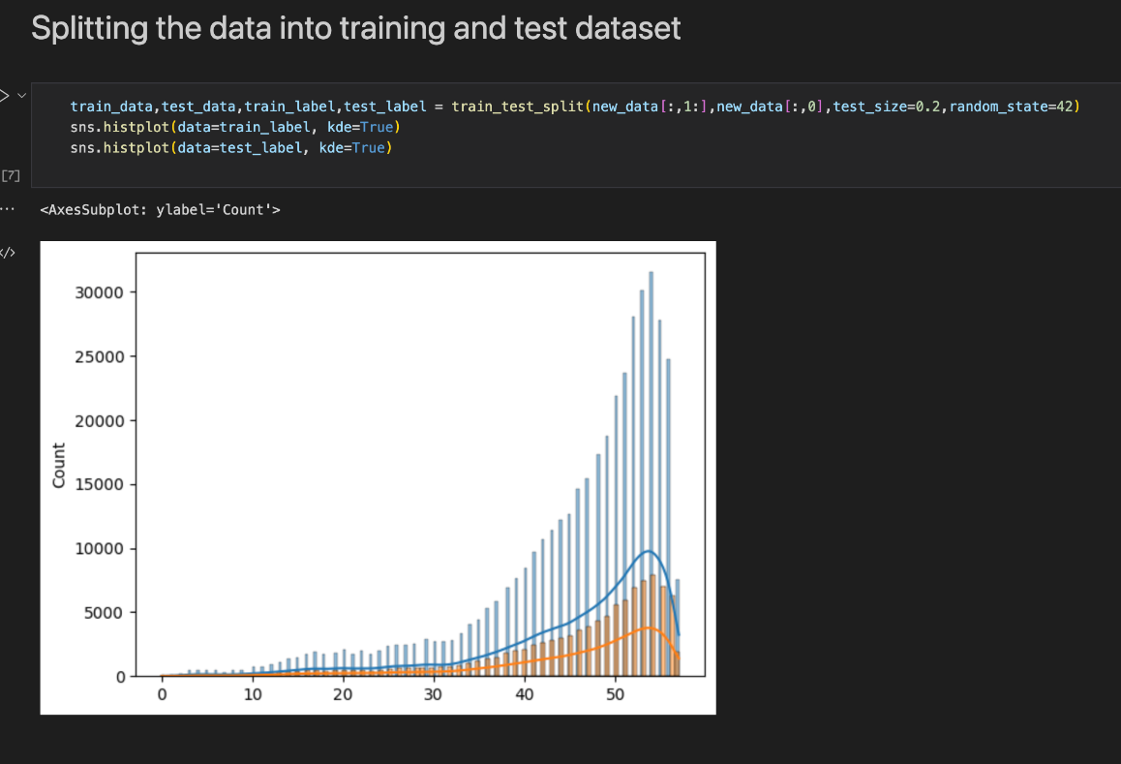
1.5 Training/Testing Split
The data was splitted into two parts.
One for training and other for testing.
Test Data was used to evaluate the performance of the models.
Figure 6: Train/Test Split

Slide 11
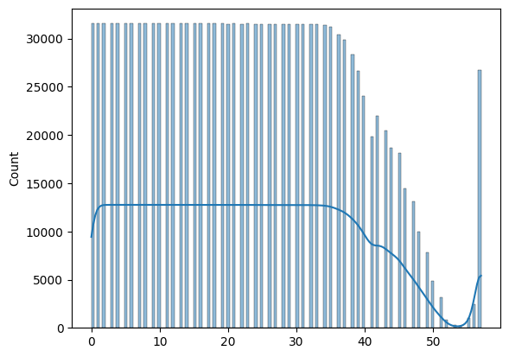
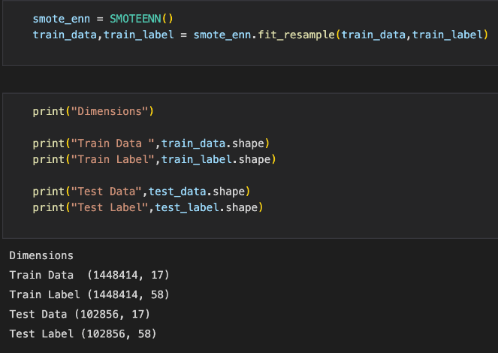
1.6 Balancing Dataset
SMOTE + ENN (Edited Nearest Neighbor)
The size of the dataset after balancing is: 1448414
Figure 6: Class distribution in balanced dataset

Slide 12
Part Two:Model and Model Performance
2.1 Logistic Regression
2.2 Decision Tree Classifier
2.3 Random Forest Classifier
2.4 Neural Network Model
2.5 Model Performance

Slide 13
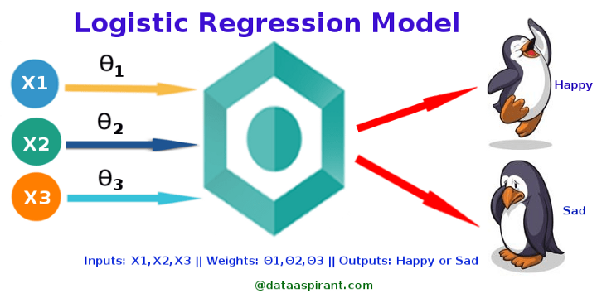
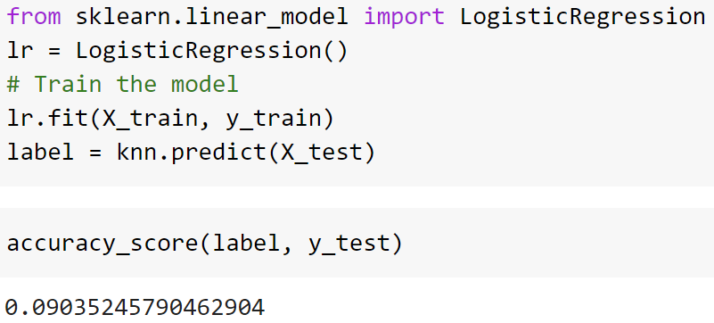
2.1 Logistic Regression
Used for prediction/classification
Types:
Binary
Multinomial
Ordinal
RMSE: 9521.48
Figure 7: Logistic Regression Model

Slide 14
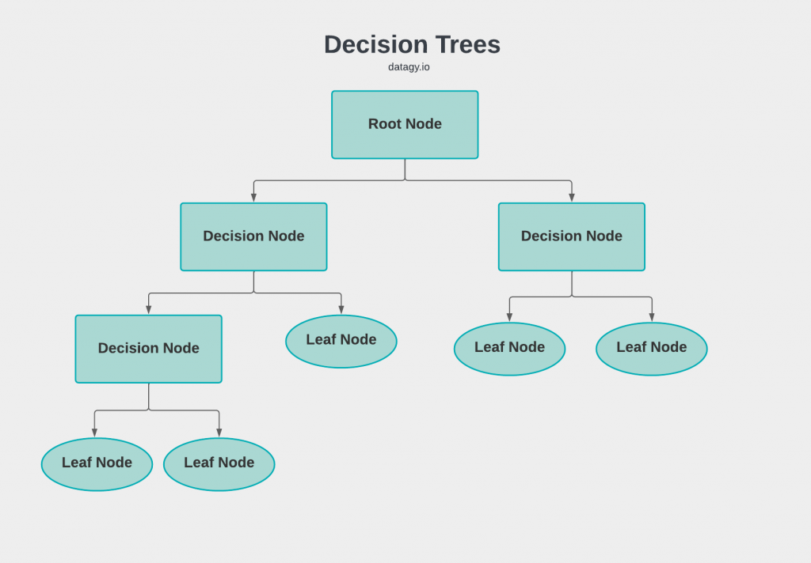
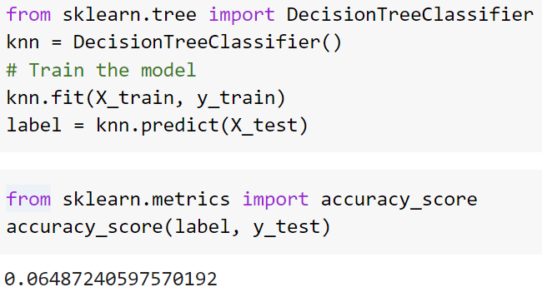
2.2 Decision Tree Classifier
Supervised ML Model
Used for both classification/Regression
Figure 8: Decision Tree Model

Slide 15
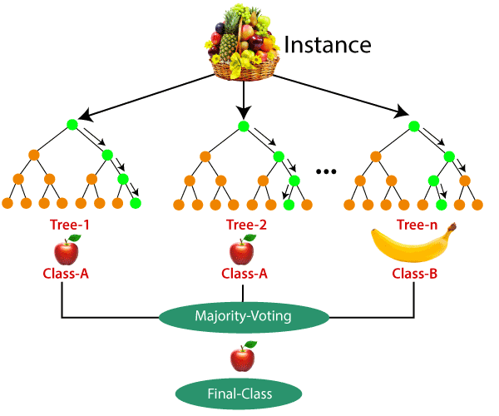
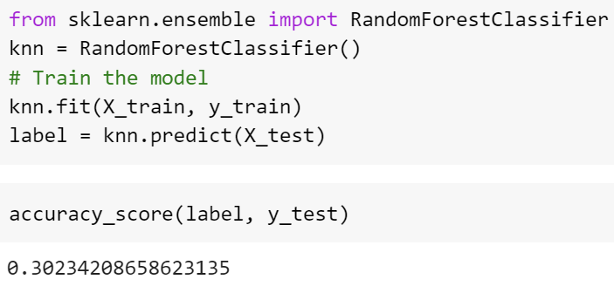
2.3 Random Forest Classifier
Supervised ML Model
Used for both classification/Regression
Creates a set of decision trees from randomly selected subset of training set
Figure 9: Random Forest Model

Slide 16
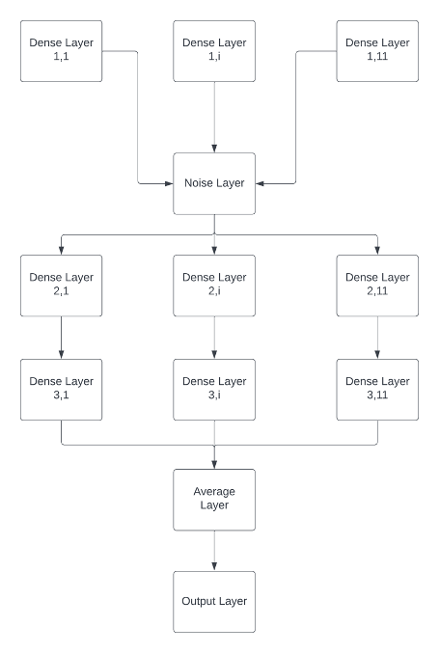
2.4 Neutral Network Model
Loss Function: Categorical Cross Entropy
Metrics: Recall, Precision, Accuracy
Employed K-Fold Cross Validation
To deal with imbalance dataset SMOTE + ENN was employed too
Figure 10: Neural Network Model

Slide 17
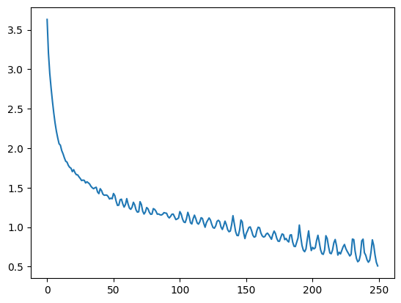
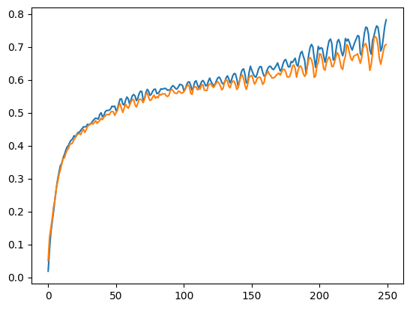
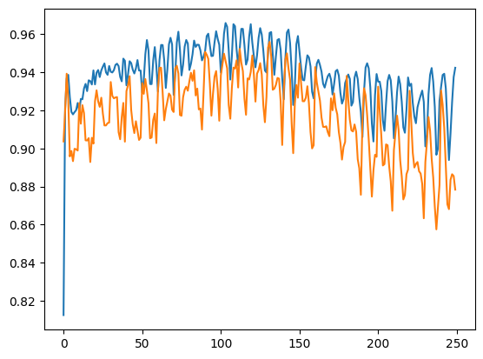
2.4 Neutral Network Performance
Precision of Model on train dataset: 94%, Recall: 88%
Precision of Model on validation dataset: 90%,
Recall: 85%
Figure 11: Loss of the model during the epochs
Figure 12: Precision vs Precision of validation dataset of model during the training
Figure 13: Recall vs Validation recall of model during the training

Slide 18
2.4 Model Performance
Model | Accuracy Score
Logistic Regression | 10%
Random Forest | 30%
Decision Tree | 7%
Neural Network | 88%
Table 1: Model Performance

Slide 19
Github Link
https://github.com/Moxi3231/song-year-prediction.git

Slide 20
References
https://towardsdatascience.com/logistic-regression-detailed-overview-46c4da4303bc
https://datagy.io/sklearn-decision-tree-classifier/
https://archive.ics.uci.edu/ml/datasets/YearPredictionMSD
https://www.geeksforgeeks.org/random-forest-classifier-using-scikit-learn/
https://towardsdatascience.com/principal-component-analysis-pca-explained-visually-with-zero-math-1cbf392b9e7d
https://www.wgu.edu/blog/neural-networks-deep-learning-explained2003.html

Slide 21
Thank You
Questions?

